Slide 1
Project 4
Titanic Survival Prediction
Group 9: David Kramer, Ji Yeol Yang, Md Mohsin Rana, Wong Yiu Chung

Slide 2
Project Aim
Using Machine Learning Models based on the dataset and test them using Supervised Learning and Neural Network to learn the relationship between passenger features and their survival outcome and subsequently make survival predictions on passenger data

Slide 3
Dataset
The famous Titanic Disaster Dataset on Kaggle
Data Information:
Survival: 0 = Did not survive, 1 = Survived
Pclass: Ticket class where 1 = First class, 2 = Second class, 3 = Third class.
Sex: Male or female
Age: Age of Passengers
SibSp: Number of siblings or spouses aboard the titanic
Parch: Number of parents or children aboard the titanic
Ticket: Passenger ticket number
Fare: Passenger fare
Cabin: Cabin number
Embarked: Point of embarkation where C = Cherbourg, Q = Queenstown, S = Southampton
Dataset Link: https://www.kaggle.com/c/titanic/data

Slide 4
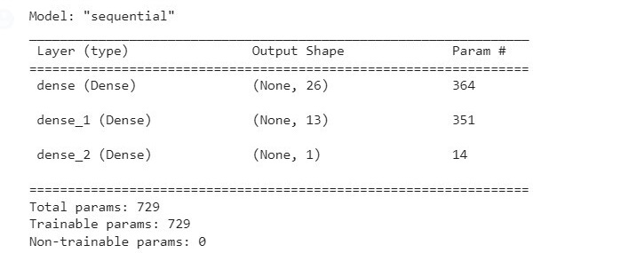
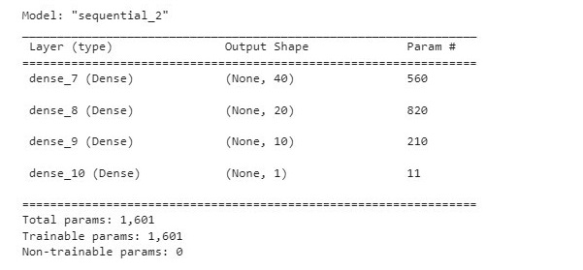
Neural Network
Original
The neural network is the first of several models we used to predict the survival outcome of the Titanic tragedy. After cleaning up and scaling the data set, we used 13 input features to predict the outcome of passenger survival. We used two hidden layers that consisted of 26 and 13 neurons, with 1 neuron in the outcome layer for binary classification purpose. The ReLu function was used as our activation function for the two hidden layers, as the function is computationally more efficient than Tanh. The function also helps to address the vanishing gradient problem, which can lead to slower training and lower accuracy.
We used the sigmoid function for our outcome layer due to its binary nature. With epoch set to 200, the model's accuracy was 0.81 with loss at 0.44.
Optimization

Slide 5
Supervised Learning: Logistic Regression
 | Actual 0 | Actual 1
predicted 0 | 172 | 31
predicted 1 | 34 | 91
As the classified and binned data, we had needed to utilize classification based supervised learning models. For a first pass we used a logistic regression model.
After training, the model achieved an overall accuracy of 80%.
With the available data, the model had the most difficulty with recall in detecting survivors.
 | Precision | Recall
0 | 0.81 | 0.85
1 | 0.75 | 0.73

Slide 6
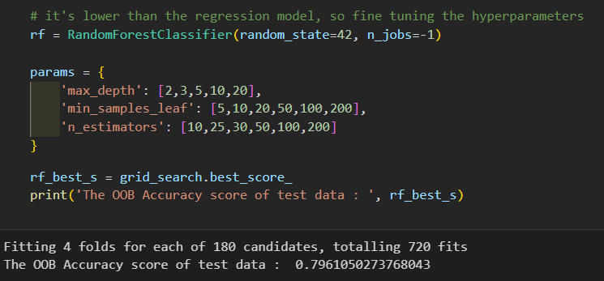
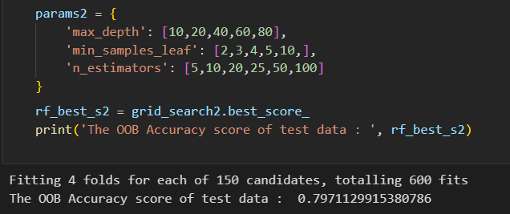
Supervised Learning: Random Forest Model
The initial randomly selected parameters yielded 79.3% accuracy.
To fine tune the model, the grid_search command was used to train the model and determine the most accurate model.
The first optimization yielded an accuracy of 79.6% with depth=20, samples/leaf=5, estimators=25
The second optimization yielded an accuracy of 79.7% with depth=20, samples/leaf=4, estimators=50

Slide 7
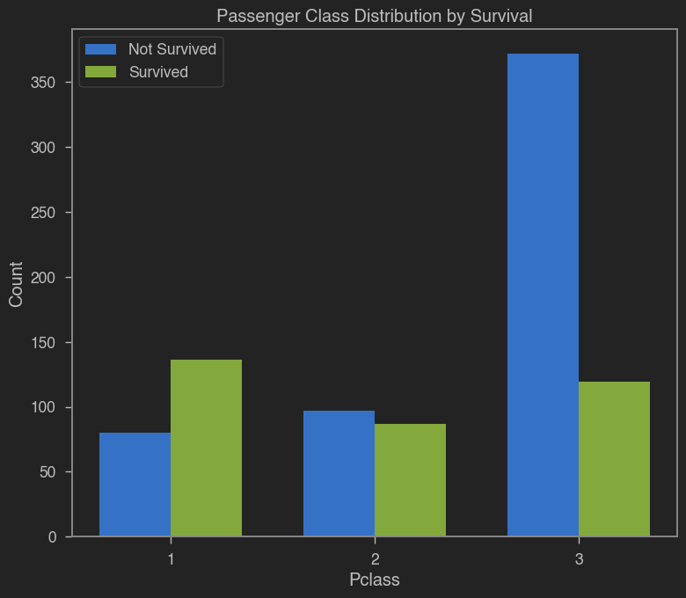
Visualizations - Survived VS Not Survived
Passengers in first class had a higher probability of survival compared to those in the other two classes. Conversely, third-class passengers experienced the lowest likelihood of survival when compared to passengers in both first and second class.

Slide 8
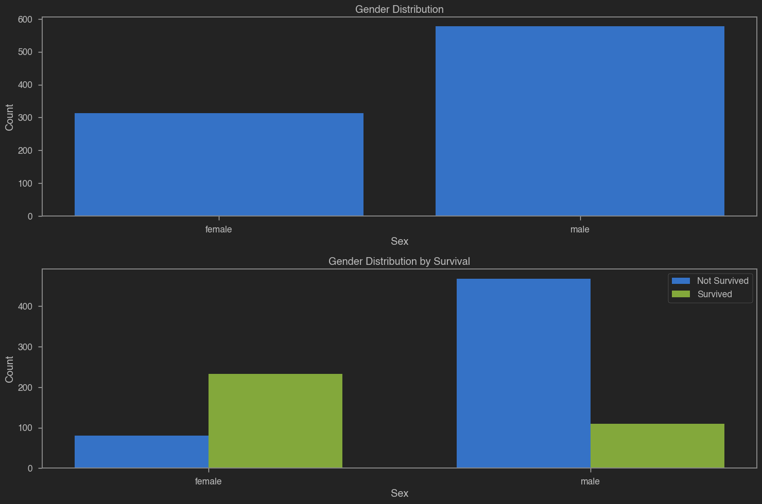
Visualizations - Sex Distribution
Female passengers exhibited a significantly higher likelihood of survival when compared to male passengers.
This observation aligns with the popular film "Titanic," where the character Rose survives, while her male counterpart, Jack, tragically loses his life.

Slide 9
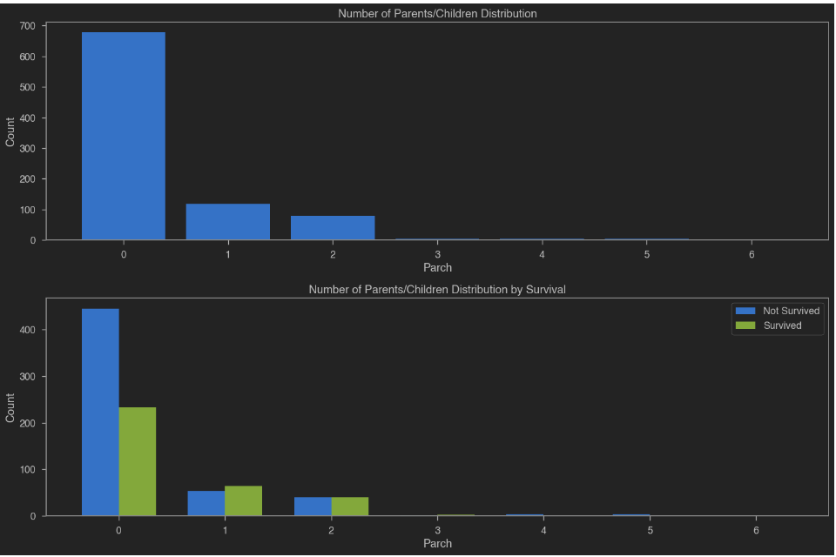
Visualizations - Sex Distribution
This chart illustrates that passengers who were accompanied by children had a greater likelihood of survival compared to those who were traveling alone.

Slide 10
Thank You

